Slide 1
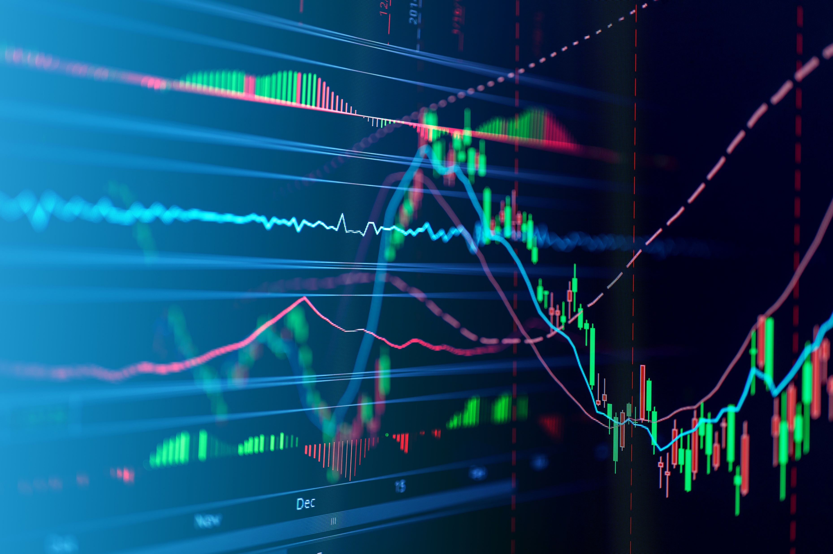
A Novel Prediction Based Portfolio Optimization Model Using Deep Learning
NARAYANAN G
I MSC- DATA SCIENCE
124150030

Slide 2
ABSTRACT
Portfolio optimization is an important part is maximizing expected return and minimizing risk. A better portfolio optimization model helps investors achieve higher expected returns under the same risk level.
This project proposes a novel prediction-based portfolio optimization model. This model uses an autoencoder (AE) for feature extraction and long short term memory (LSTM) network to predict stock return, then predicted and historical returns are utilized to build a portfolio optimization model by advancing worst-case omega model.
An equally weighted portfolio is considered as a comparison to reveal the advantage of the worst-case omega model.
To find optimal portfolio optimization model by using AE+LSTM+OMEGA MODEL

Slide 3
INTRODUCTION
Utilizing ML models for stock return prediction and using predictive errors instead of historical returns in building portfolio optimization models.
To further improve the out-of-sample performance of prediction-based portfolio optimization models, project proposes a new model called AE+LSTM+OMEGA.
This model combines an autoencoder (AE) for feature extraction, a long short-term memory (LSTM) network for stock return prediction, and the worst-case omega model for portfolio optimization.
It applies AE for feature extraction, uses LSTM with extracted features to predict stock returns, selects stocks with higher predicted returns, and incorporates predictive errors in the worst-case omega model.
The model generates multiple objective functions based on predicted and historical returns and converts them into a single objective using the linearity weighted method.
This project aims to develop an improved prediction-based portfolio optimization model that integrates AE, LSTM, and the worst-case omega model. The model enhances stock selection, incorporates predictive errors, generates multiple objective functions, and demonstrates superior performance compared to existing models.

Slide 4
MODEL COMPARISON
Portfolio optimization
01
Portfolio optimization using AE+LSTM+OMEGA
02

Slide 5
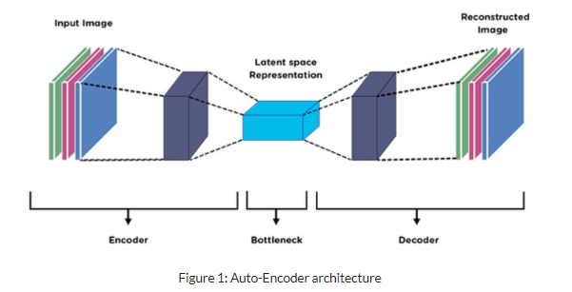
Autoencoder

Slide 6
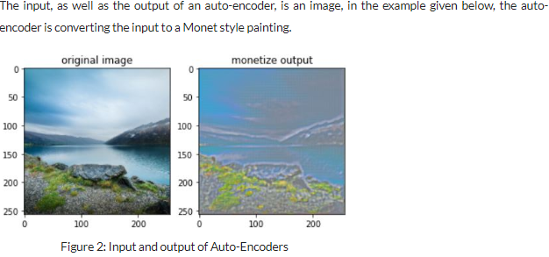
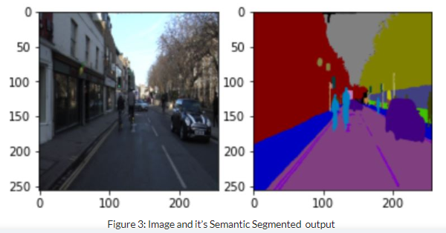
Example of Auto encoder
Input and output of AE
Image and it’s Semantic Segmented Output

Slide 7
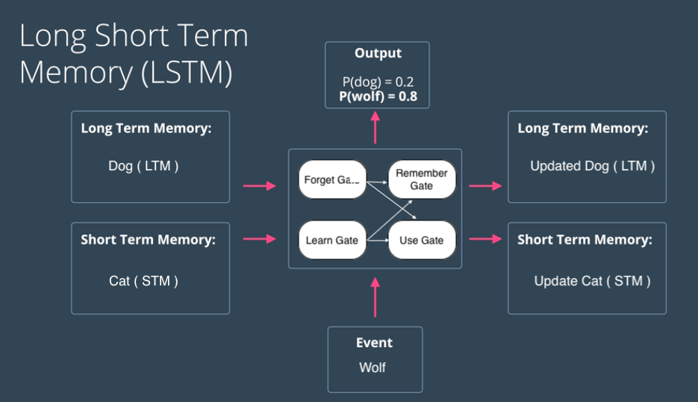
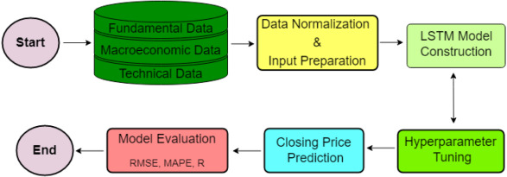
LONG SHORT-TERM MEMORY (LSTM)

Slide 8
METHODOLOGY
It defines a class called `Portfolio` that represents a portfolio of stocks. The class has methods to calculate the risk and return for individual stocks .
The `risk_return_individual()` method takes in the ticker symbols of the stocks in the portfolio, downloads the historical price data using `yfinance`, calculates the daily returns for each stock, and then calculates the expected returns and risk (standard deviation of returns) for each stock. It stores the individual returns and risks in `indi_ret` and `indi_risk` lists, respectively.
The `portfolio_return()` method calculates the expected return for the portfolio by multiplying the weights of each stock with their respective expected returns and summing them up. The portfolio return is stored in the `port_ret` list.

Slide 9
The `portfolio_risk()` method calculates the portfolio risk using the formula: sqrt(w1^2 * σ1^2 + w2^2 * σ2^2 + ... + 2 * w1 * w2 * Cov1,2 + ...), where wi is the weight of the ith stock, σi is the risk (standard deviation) of the ith stock, and Cov1,2 is the covariance between stocks 1 and 2. It uses a covariance matrix to calculate the covariances between stocks. The portfolio risk is stored in the `portfo_risk` list.
The code then prompts the user to enter the number of portfolios to be evaluated (`get_por`). For each portfolio, it asks for the number of companies in the portfolio (`n_companies`), the ticker symbols of the companies, and the weights assigned to each company. It creates a `Portfolio` object for each portfolio and calculates the portfolio return and risk.

Slide 10
Then we pass the closing data to be performing stock price prediction using an LSTM-based autoencode .For each ticker symbol in the `tc` list, the code uses the `yfinance` library to download data . The downloaded data is then saved to a CSV file named 'stock.csv
After downloading the data for all ticker symbols, the code proceeds to load the stock data from the 'stock.csv' file using pandas.
Preprocessing of the data begins by scaling the 'Close' column values using the MinMaxScaler from `sklearn.preprocessing`.
The Omega model is defined by creating an input layer of autoencoder input and connecting it to the encoded data obtained from the autoencoder model.
The LSTM model is consists of an LSTM layer followed by a dense layer for prediction with adam optimizer and mean squared error (MSE) loss.
The model is trained by fitting the training data to itself for a specified number of epochs.

Slide 11
The difference between the actual test data and the predicted test data is calculated, flattened, and stored in the variable `D`.The model is evaluated by calculating the mean squared error (MSE) between the actual and predicted test data.
The MSE value is printed as "Mean Squared Error".
The RMSE value is printed as “Root Mean Squared Error".
Overall, the code performs stock price prediction using an LSTM-based autoencoder and LSTM model. The autoencoder is used to learn a compressed representation of the input data, and the LSTM model is used for sequence prediction based on the encoded data. The model is evaluated using mean squared error to assess its prediction performance.

Slide 12
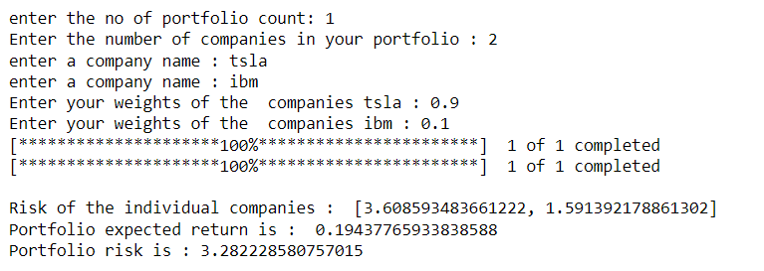
RESULTS & DISCUSSION
4.1 portfolio for IBM & GOOG: The normal portfolio of IBM and GOOG are produce some individual risk, individual return, portfolio risk and portfolio return. Based on weights for each stock in portfolio .

Slide 13
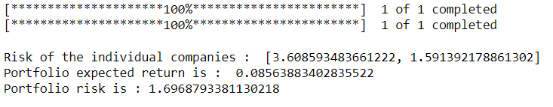
4.2 Portfolio Expected Return and Risk by using AE+LSTM+OMEGA: The expected return of the portfolio is estimated to be approximately 0.085%. This value represents the average potential gain of the portfolio based on the chosen allocation. The portfolio risk is measured by the standard deviation, and it is estimated to be approximately 1.696 %. This metric provides an indication of the potential volatility or variability in the portfolio's value.

Slide 14
Challenges & Limitation
The combination of an Autoencoder (AE), Long Short-Term Memory (LSTM), and OMEGA (One Model for Ensemble Generation and Analysis) :
Complexity and computational requirements
Data preprocessing and feature engineering:
Hyperparameter tuning:
Model interpretability:
Overfitting:
Lack of robustness to concept drift
Scalability:
Data availability and quality:

Slide 15
Future Work
In future I going to develop this project some other machine learning model and deep learning model for selecting best stock for portfolio
In this project I am using AE+LSTM+OMEGA
In future I combine this project with AE+LSTM+OMEGA+EW, AE+LSTM+OMEGA+optimizer

Slide 16
CONCLUSION
The first part is a Python script that calculates the risk and return for multiple portfolios consisting of different stocks. It defines a `Portfolio` class with methods to calculate individual stock returns and risks, as well as portfolio returns and risks. The code prompts the user to enter the number of portfolios and the details of each portfolio, and then calculates and stores the returns and risks in separate DataFrames.
The second part is an example of code for stock price prediction using an LSTM-based autoencoder and LSTM model. It downloads historical stock price data, preprocesses it, defines and trains the models, makes predictions, and evaluates the model's performance using mean squared error.

Slide 17
REFERENCES
https://www.simplilearn.com/tutorials/deep-learning-tutorial/what-are-autoencoders-in-deep-learning
https://www.wallstreetmojo.com/portfolio-optimization/
https://cleartax.in/s/stock-market-analysis
https://www.tensorflow.org/api_docs/python/tf/keras/layers/LSTM
https://towardsdatascience.com/omega-ml-deploying-data-machine-learning-pipelines-the-easy-way-a3d281569666
https://finance.yahoo.com/?guccounter=1&guce_referrer=aHR0cHM6Ly93d3cuZ29vZ2xlLmNvbS8&guce_referrer_sig=AQAAAML8ULHkJD-unt1DB-e_yQRPH9yDdUXEVoHXlGosyGZzCi4M2GkZ0GRzeuYsRstQc5JfgLvalwdqQPU6gu7GL1iZQ0u3SJgKzIDqLTG2zTBuLhbqpmZoanW9083L-C51hIR19sZT2vcSa4XMJreSnOi73PhHhDbtyRdks7J9XVjX

Slide 18
THANK YOU

